Slide 1
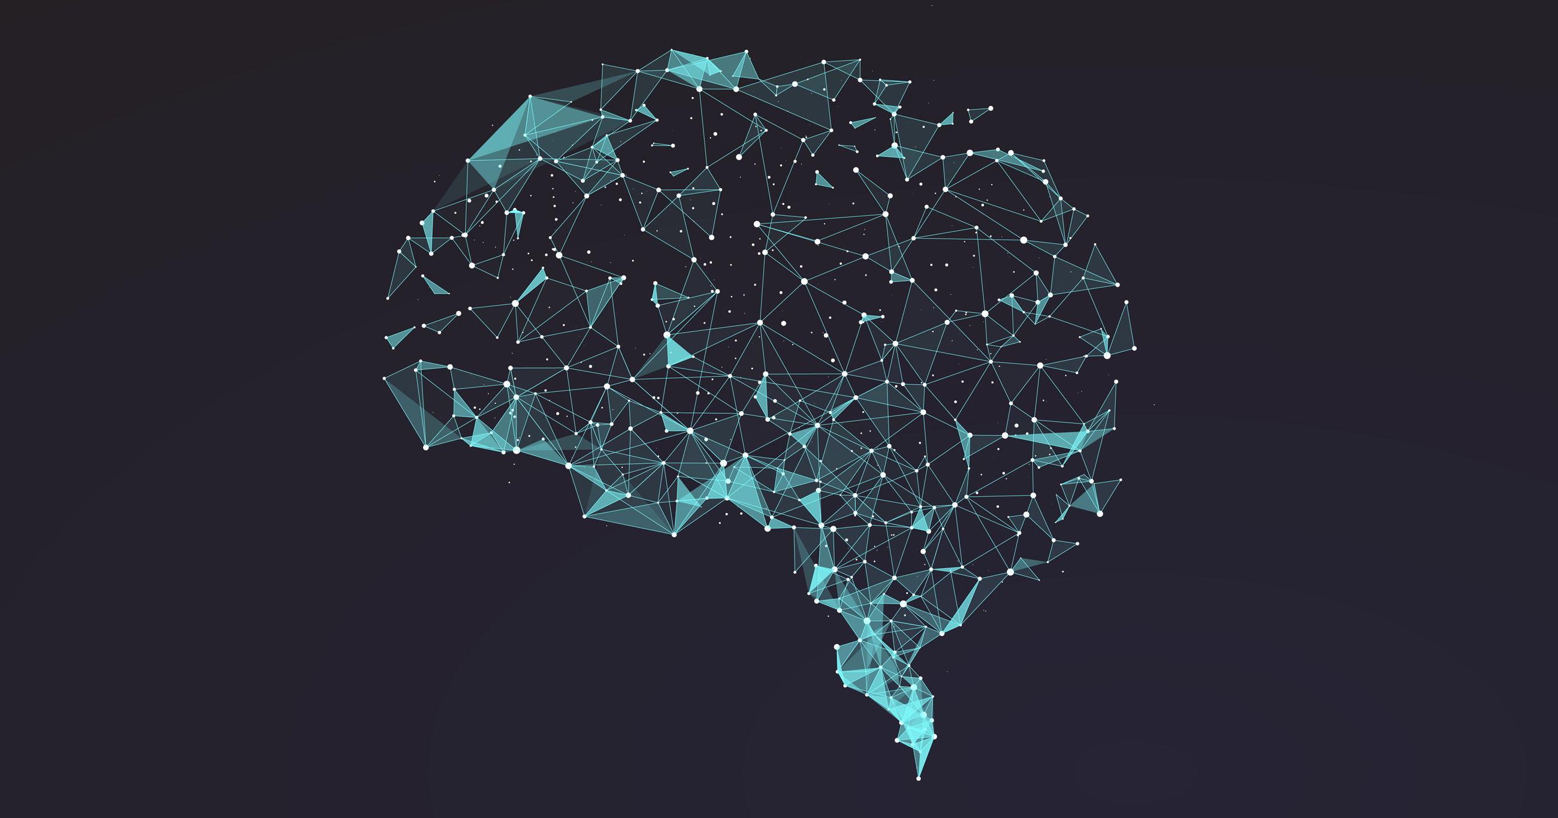
Masterclass
Neural Networks

Slide 2
Use Cases

Slide 3
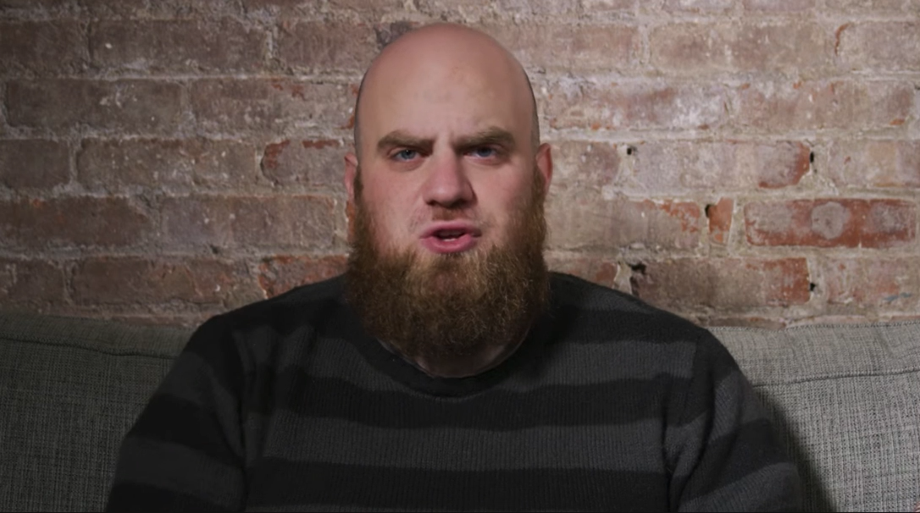

Slide 4
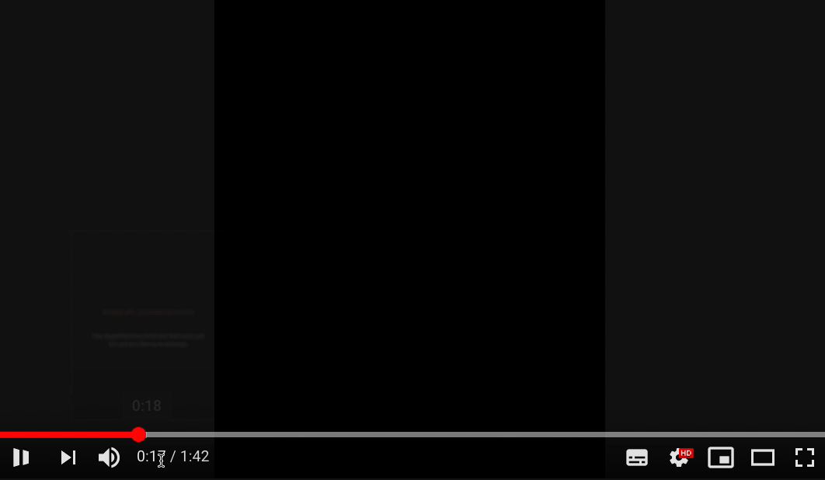

Slide 5
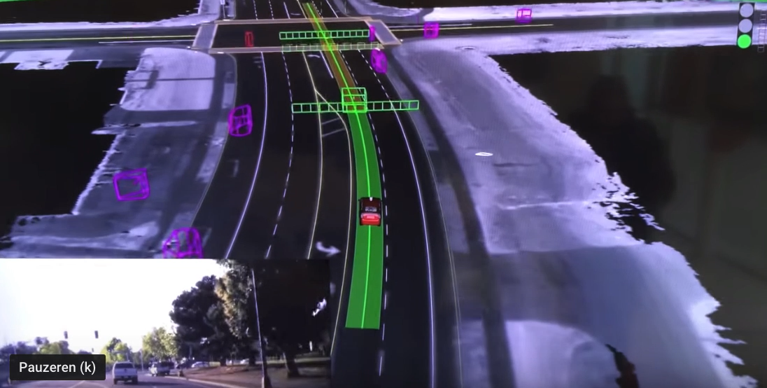

Slide 6
Patterns

Slide 7
Real life
Take your first step
You fall! Learn from this experience
Take another step
Yes!
Neural network
Make a prediction
Wrong! Learn from this experience
Make another prediction
Yes!

Slide 10
Neural
Network

Slide 12
Key-words
Input
Output
Weights
Activations
Learning Rate
Feed forward
Back propagation

Slide 14
HIDDEN
LAYER
INPUT
Red and round
ACTIVATION
0.2
OUTPUT
Color
0
0.6
0 = red
1 = yellow
0.6
WEIGHTS
Fruit
0.4
0.3
Shape
1
0 = long
1 = round
Yellow and long

Slide 15
Red and round
0.2
Color
0
0.6
0 = red
1 = yellow
0.6
Fruit
0.4
0.3
Shape
1
0.3
0 = long
1 = round
Yellow and long

Slide 16
FEED FORWARD
Red and round
0.2
Color
0
0.6
0 = red
1 = yellow
0.6
Fruit
0.4
0.3
Shape
1
0.3
0 = long
1 = round
Yellow and long

Slide 17
Red and round
0.2
Color
1
0.2
0 = red
1 = yellow
0.6
Fruit
0.4
0.3
Shape
0
0 = long
1 = round
Yellow and long

Slide 18
Red and round
0.2
Color
1
0.2
0 = red
1 = yellow
0.6
Fruit
0.4
0.3
Shape
0
0.4
0 = long
1 = round
Yellow and long

Slide 19
Red and round
0.2
Color
1
0.2
0 = red
1 = yellow
0.6
Fruit
0.4
0.3
Shape
0
0.4
0 = long
1 = round
Yellow and long

Slide 21
Red and round
0.7
Color
1
0.7
0 = red
1 = yellow
0.2
Fruit
0.6
0.6
Shape
0
0 = long
1 = round
Yellow and long

Slide 22
Red and round
0.7
Color
1
0.7
0 = red
1 = yellow
0.2
Fruit
0.6
0.6
Shape
0
0.6
0 = long
1 = round
Yellow and long

Slide 23
Red and round
0.7
Color
1
0.7
0 = red
1 = yellow
0.2
Fruit
0.6
0.6
Shape
0
0.6
0 = long
1 = round
Yellow and long

Slide 24
LEARNING RATE
BACK PROPAGATION
Red and round
0.7
0.5
Color
1
0.7
0 = red
1 = yellow
0.2
Fruit
0.6
0.8
0.6
Shape
0
0.6
0 = long
1 = round
Yellow and long

Slide 25
Red and round
0.5
Color
1
0.5
0 = red
1 = yellow
0.2
Fruit
0.8
0.6
Shape
0
0.8
0 = long
1 = round
Yellow and long

Slide 26
Let’s do this!

Slide 27
Input |  | Output
0 | 0 | 0
1 | 0 | 1
0 | 1 | 1
1 | 1 | 0
Neural Networks

Slide 28
Recap
Learning similar to human learning
Mathematics
Neural Network Parts:
Nodes
Layers
Weights (+ biases)
Feed forward
Back propagation

Slide 29
What’s next?

Slide 30
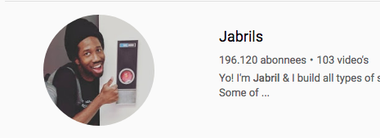
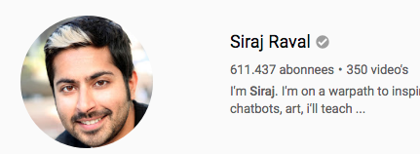
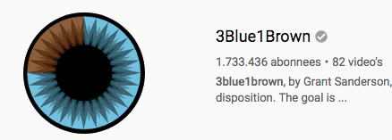
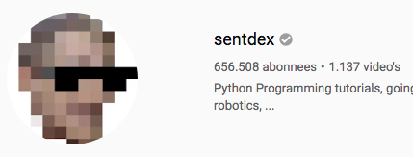

Slide 31
Thank you

Slide 32
Use Cases

Slide 36
Patterns

Slide 37
Real life
Take your first step
You fall! Learn from this experience
Take another step
Yes!
Neural network
Make a prediction
Wrong! Learn from this experience
Make another prediction
Yes!

Slide 40
Neural
Network

Slide 42
Key-words
Input
Output
Weights
Activations
Learning Rate
Feed forward
Back propagation

Slide 44
HIDDEN
LAYER
INPUT
Red and round
ACTIVATION
0.2
OUTPUT
Color
0
0.6
0 = red
1 = yellow
0.6
WEIGHTS
Fruit
0.4
0.3
Shape
1
0 = long
1 = round
Yellow and long

Slide 45
Red and round
0.2
Color
0
0.6
0 = red
1 = yellow
0.6
Fruit
0.4
0.3
Shape
1
0.3
0 = long
1 = round
Yellow and long

Slide 46
FEED FORWARD
Red and round
0.2
Color
0
0.6
0 = red
1 = yellow
0.6
Fruit
0.4
0.3
Shape
1
0.3
0 = long
1 = round
Yellow and long

Slide 47
Red and round
0.2
Color
1
0.2
0 = red
1 = yellow
0.6
Fruit
0.4
0.3
Shape
0
0 = long
1 = round
Yellow and long

Slide 48
Red and round
0.2
Color
1
0.2
0 = red
1 = yellow
0.6
Fruit
0.4
0.3
Shape
0
0.4
0 = long
1 = round
Yellow and long

Slide 49
Red and round
0.2
Color
1
0.2
0 = red
1 = yellow
0.6
Fruit
0.4
0.3
Shape
0
0.4
0 = long
1 = round
Yellow and long

Slide 51
Red and round
0.7
Color
1
0.7
0 = red
1 = yellow
0.2
Fruit
0.6
0.6
Shape
0
0 = long
1 = round
Yellow and long

Slide 52
Red and round
0.7
Color
1
0.7
0 = red
1 = yellow
0.2
Fruit
0.6
0.6
Shape
0
0.6
0 = long
1 = round
Yellow and long

Slide 53
Red and round
0.7
Color
1
0.7
0 = red
1 = yellow
0.2
Fruit
0.6
0.6
Shape
0
0.6
0 = long
1 = round
Yellow and long

Slide 54
LEARNING RATE
BACK PROPAGATION
Red and round
0.7
0.5
Color
1
0.7
0 = red
1 = yellow
0.2
Fruit
0.6
0.8
0.6
Shape
0
0.6
0 = long
1 = round
Yellow and long

Slide 55
Red and round
0.5
Color
1
0.5
0 = red
1 = yellow
0.2
Fruit
0.8
0.6
Shape
0
0.8
0 = long
1 = round
Yellow and long

Slide 56
Let’s do this!

Slide 57
Input |  | Output
0 | 0 | 0
1 | 0 | 1
0 | 1 | 1
1 | 1 | 0
Neural Networks

Slide 58


Input layer
Weights 1
Hidden layer
Weights 2
Output layer
1
W1
1
W2
W1
0
b1
1
W1
W1
W2
1
0
b2
b1

Slide 59
Recap
Learning similar to human learning
Mathematics
Neural Network Parts:
Nodes
Layers
Weights (+ biases)
Feed forward
Back propagation

Slide 60
What’s next?

Slide 62
Thank you

